Slide 1
XXE – XML External Entity Injection

Slide 2
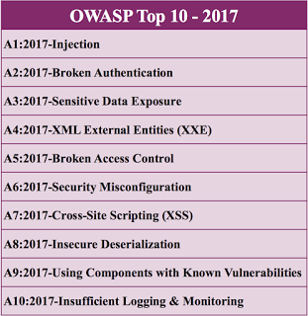
OWASP Top 10 Web Vulnerabilities

Slide 3
What is XML and How it Works
XML is eXtensible Markup Language.
Structured Language
It simplifies data sharing, transport and data availability.
Used typically between different endpoints to share information – data shared/stored becomes hardware/software independent.

Slide 4
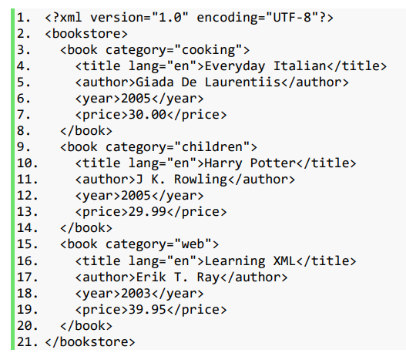
XML Example

Slide 5
What is DTD
DTD is the XML Document Type Declaration.
It defines structure and legal elements/attributes.
Verifies if XML data is in proper format
It is a way to describe XML language precisely
It can be internal or external.

Slide 6
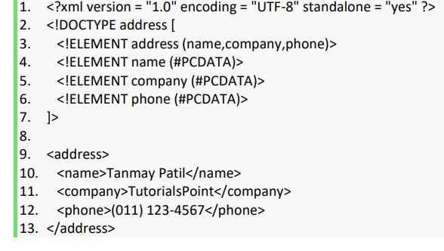
Internal DTD Example
DOCTYPE: root element
PCDATA : parsed character data

Slide 7
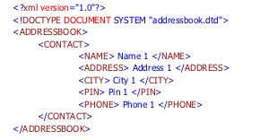
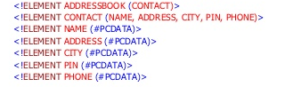
External DTD Example
Addressbook.xml
Addressbook.dtd

Slide 8
Entities
Entities are used to define shortcuts to other text
<!ENTITY entity-name "entity-value">
Internal
<!ENTITY foo “bar”>
External
<!ENTITY foo SYSTEM “file:///etc/passwd”>
( To refer the Entity in XML document use &foo; )
Parameter
<!ENTITY % foo “value”>

Slide 9
What is XXE
This attack occurs when XML input containing a reference to an external entity is processed by a weakly configured XML parser.
Applications:
Port scan
DoS
SSRF
Local file inclusion (read only)
RCE

Slide 10
XXE Injection Example
POST / HTTP/1.1
Host: abc.com
User-Agent: Mozilla/5.0 (Windows NT 10.0; Win64; x64; rv:69.0) Gecko/20100101 Firefox/69.0
Accept-Language: en-US,en;q=0.5
Accept-Encoding: gzip, deflate
Content-Type: application/xml
Content-Length: 107
Connection: close
Referer: https://xyz.com
<?xml version="1.0" encoding="UTF-8"?>
<!DOCTYPE foo [<!ENTITY xxe "thisistest"> ]>
<userInfo>
<firstName>John</firstName>
<lastName>&xxe;</lastName>
</userInfo>
Output:
Hello John thisistest

